Slide 1
Lock and Key
Resumes for Work and College
Notes:
We can't cover everything in this short presentation, so we've put the slides, handouts, and links to other useful articles on our website, groversenglish.com.

Slide 2
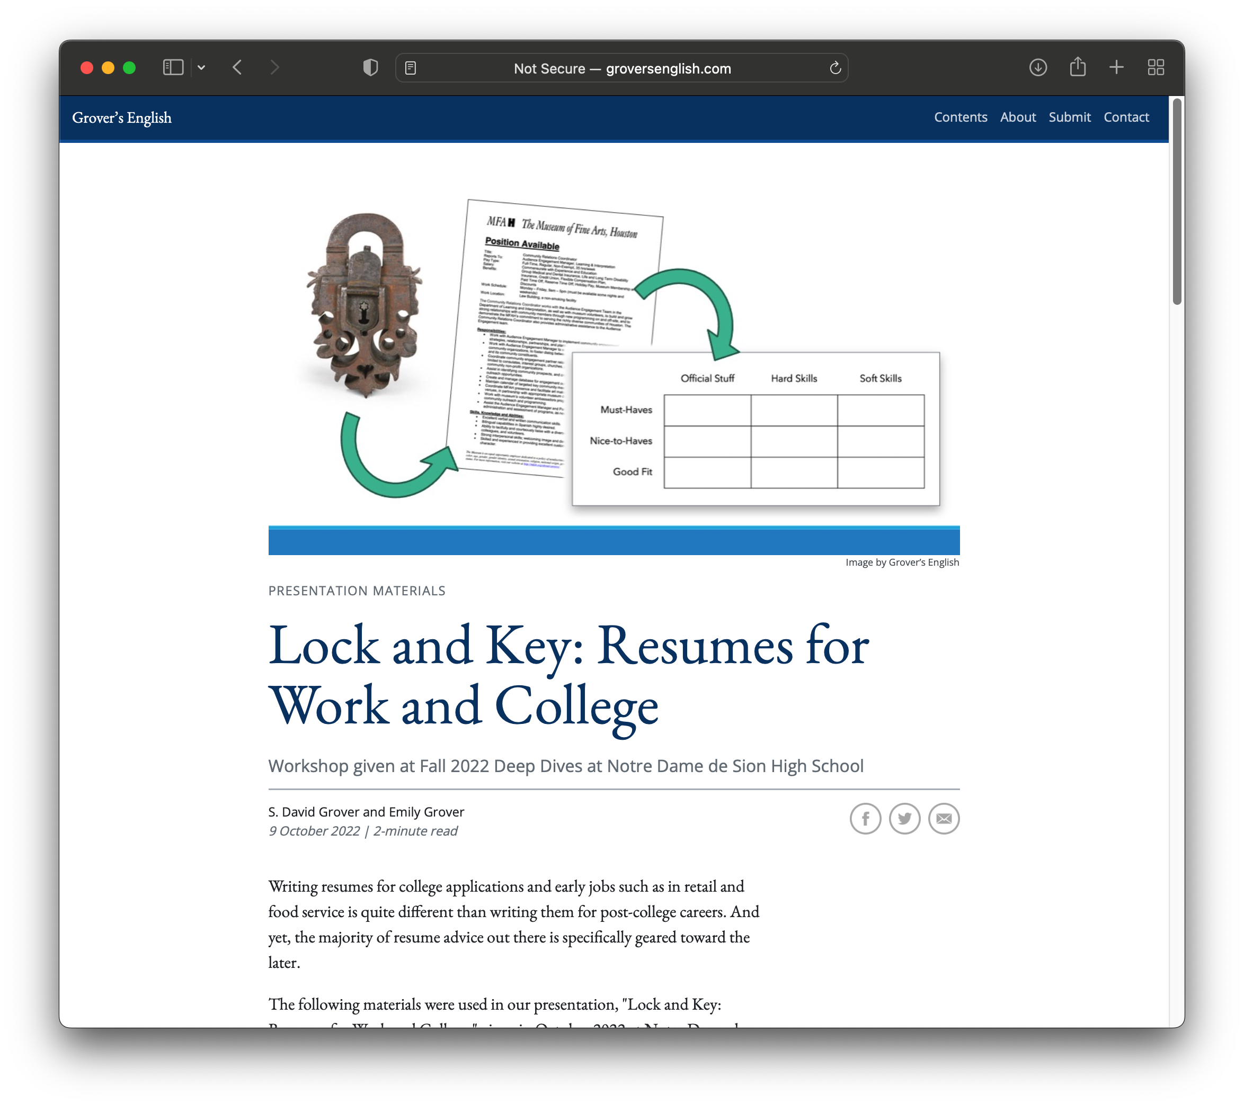
For more info, slides, handouts, etc.
groversenglish.com

Slide 3

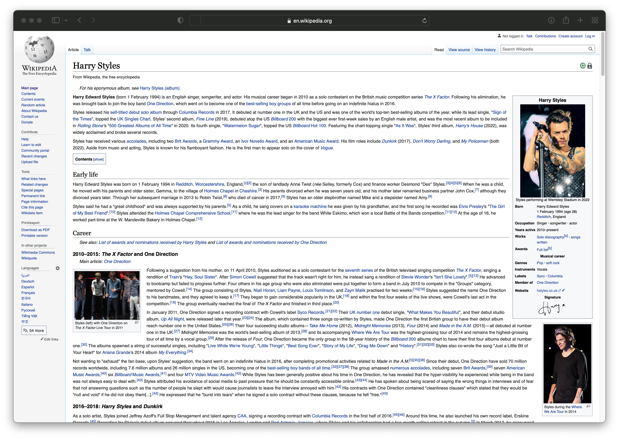
The Biggest Mistake with Resumes
Notes:
The biggest mistake people make with resumes is they treat them like a life story or a reference document that has to cover everything. Resumes are not these.

Slide 4
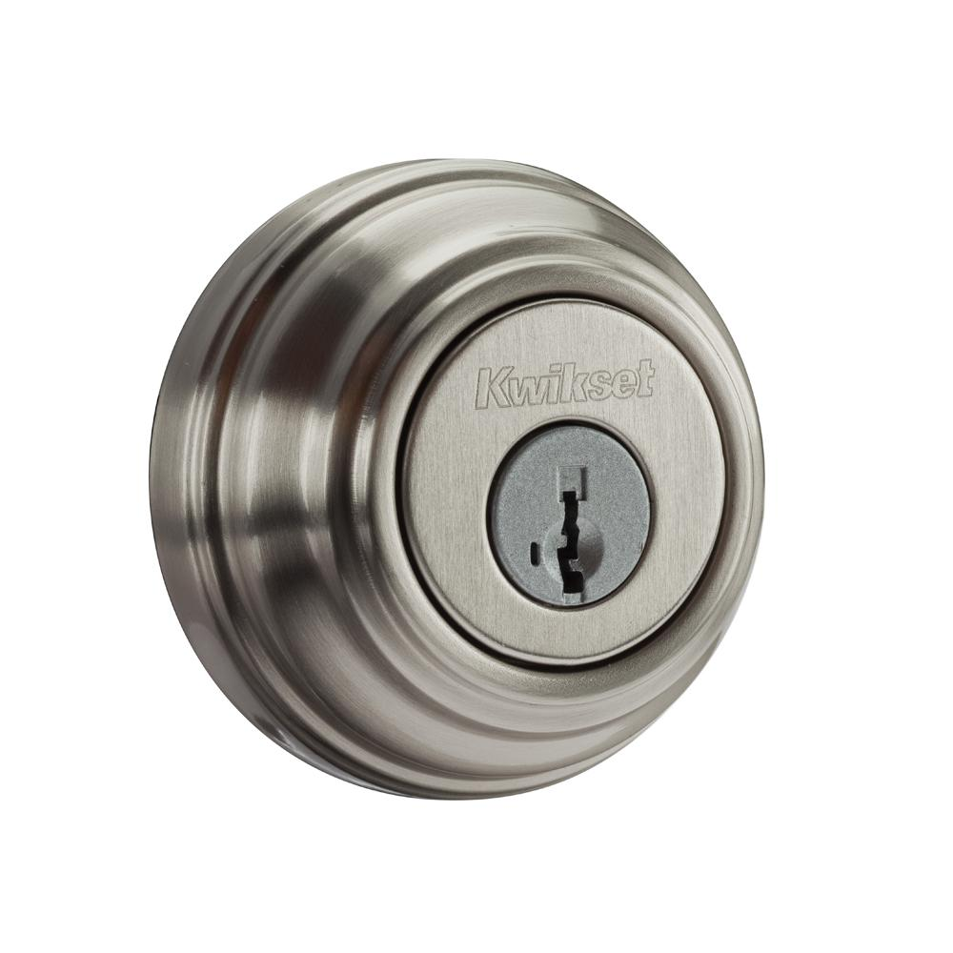



EMPLOYER
Notes:
The proper way to think about a resume is to think about it from the employer’s/college’s perspective. When an employer goes to hire, it’s because they have a job that needs doing. As an analogy: they have a lock that needs to be opened. They are looking for the key—that is, the person with the right skills and characteristics to open that lock.

Slide 5

RESUMES
Notes:
It can be frustrating to think about sending out a resume that will end up in a huge stack and only get a few seconds of the employer’s attention before they decide who to interview. But because so many people don’t understand what a resume is really for, they quickly put themselves out of the running.

Slide 6


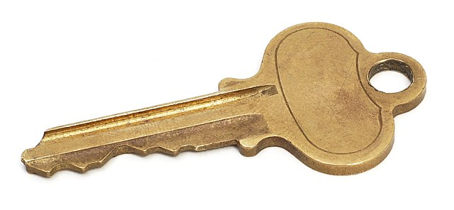

RESUMES
Notes:
A large portion of resumes turned in for the average job are life stories, and the reader can’t see in the 10 seconds they have to spare whether, amongst all that detail, the person in question looks like the right key.
Another portion of resumes are more focused, presenting their writers as keyrings, able to open a wide variety of locks. While it’s good to have a lot of needed skills, again it’s hard for the reader to determine in just a few seconds whether one of those keys can open their lock.
The only resumes you’ll actually be competing against are those that present the writer as a single key, one that looks like it’ll open the lock in question. In other words, the ones that cut all the unnecessary stuff and clearly indicate that the writer has the skills and characteristics the employer is looking for. These people are the ones who get called in for interviews.

Slide 7
Notes:
Here are two resumes from the same fictitious Sion student. Same person, but presented as different keys. If you look closely, you’ll see how she presents herself one way to appeal to a college (left) and another way to appeal to an employer (right). For example, on the left she lists the jobs she’s held, but she doesn’t go into detail about what she did at those jobs, and she puts them in an out of the way space. This is because, while having a job indicates she is responsible and can multitask and learn new skills (all things a college is looking for in students), the university doesn’t need other details to get that message and other things she can include on the resume make a stronger argument about her “key-ness” for college.
When applying for a new job, however, it makes sense for her to put her previous work experience near the top and to go into detail about what she did in those jobs and what skills she developed there.

Slide 8
Understanding the Lock
What are they actually look for?
Notes:
Good news! When we’re talking about college admissions and the types of jobs teenagers typically get (food service, retail, etc.), the ”locks” are generally the same across the board.

Slide 9
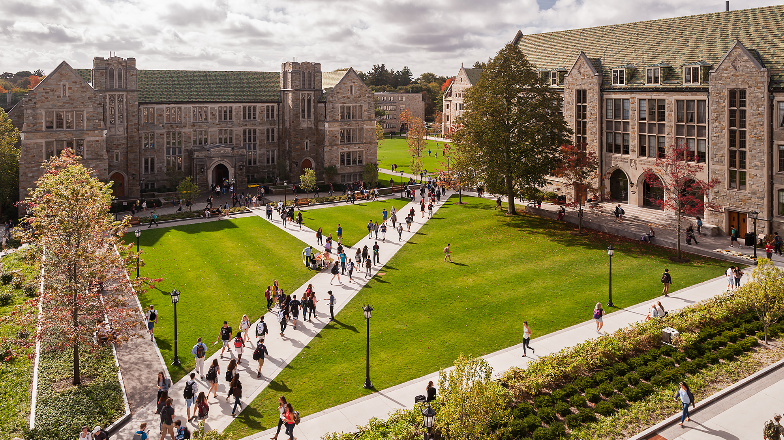
College
COLLEGE
Doesn’t Give Up Easily
Clear Vision of College and Future
Omnivorously Curious
Will Increase School’s Prestige
Intelligent
Notes:
Universities across the country are all looking for the same basic type of student, shown here. Admitting a student is a risk for the university—anyone they admit means there’s another student they can’t admit, and if the student drops out before earning a degree, that’s a lot of money, resources, and reputation gone to waste (and nationally, the number of students who finish a degree within 6 years of starting is quite low).
Make your resume (and other application materials) convey these attributes about you to have the best chance for admission.

Slide 10

EARLY JOBS
Can Follow Instructions
Can Learn New Skills
Treat Customers Well
Punctual and Reliable
Notes:
Food service, retail, manual labor, lifeguarding, and beginning office jobs don’t tend to require a bunch of elaborate hard skills—those types of jobs are reserved for those who finish college or trade school or apprenticeships. So what are employers looking for from teenagers? These qualities!

Slide 11
Fashioning the Key
What to Put in your resume

Slide 12
MASTER RESUME
TAILORED RESUMES
Notes:
If it seems like we’re advocating that you write a new resume for each application, you’re right. That is what we’re advocating. But there’s a trick to doing that.
We suggest you begin now compiling a “big list” or ”master resume” of everything you do that might be useful on a resume someday. Then, when you need to tailor a resume for a specific job, you can just pull items from your master resume to get the job done quickly. While this won’t be super important right now for you, you’ll be happy you started keeping a big list now when you finish college and write your first resumes for your career.

Slide 13
Remember
When making a master resume, give full, expansive details.
When tailoring a resume, decide what to include where to scale back on detail.
Details left out of a tailored resume can be used in interviews.
Notes:
We always read over our master resume the night before a job interview so that we have heads full of stories we can use to answer questions like “Tell me about a time you pacified a frustrated customer” or “Give me an example of a time you used criticism from your boss to improve.”

Slide 14
Build a Resume
List elements needed to open lock
Choose items from master resume to include
Choose level of detail for each item
Create needed sections
Formatting last!
Notes:
Don’t worry about formatting for your resume at first. While formatting can be impressive and fun to tinker with, the truth is that it can’t get you a job (though bad formatting can prevent it!). The content of your resume is what shows you to be the key they are looking for, so figure out what the lock looks like, choose what you want to include in your tailored resume, and get the wording right. Then you can worry about cramming it all on one page.

Slide 15
Levels of Detail
Notes:
When moving from a master resume to a tailored resume, the question is how much detail you should include. For the most important things you want to convey (a particular skill or characteristic or experience), you should ratchet up the detail you give. For less important things or things that are merely there to round you out and show breadth, you’ll want to scale back on the detail.
The following slides give examples of how you can scale back or ratchet up the detail on a wide variety of resume entries.

Slide 16
Education
Notre Dame de Sion High School, May 2023
Kansas City, MO
GPA: 3.78
Diploma, May 2023
Notre Dame de Sion High School, Kansas City, MO
Notes:
The basics of your education are the school name and date of graduation. The location of your school might be needed if your school won’t be known to your reader, and you can include your GPA if it’s impressive.
There are different ways of arranging this basic information, as shown in these two examples.

Slide 17
Education
Notre Dame de Sion High School, May 2023
Kansas City, MO
Magna Cum Laude Honors: received in 5 quarters
3.8 GPA and above, no grade below B
Notes:
What if your overall GPA isn’t good but you were on the honor roll several times? Here’s one way to hide the GPA but brag about the good quarters you had.

Slide 18
Education
Notre Dame de Sion High School, May 2023
Kansas City, MO
Honor Roll: Fall I 2020, Fall II 2020, Spring II 2021
Notes:
There are lots of ways of convey the info—here’s another example. Not all schools use the same terminology (few schools, for example, use the Latin cum laude for the honor roll), so it’s okay to either explain what it means (previous slide) or change the wording to something more universal (seen here).

Slide 19
Education
Notre Dame de Sion High School, May 2023
Kansas City, MO
GPA: 3.78
Selected Coursework
AP Calculus, 2021–2022
Designing Real-World Impacts (senior English), 2022–2023
French IV, 2022–2023
Notes:
What if you’ve taken advanced or special topics courses that might impress your reader? You can definitely include those—maybe in the education section, or maybe in a section of their own, depending on the situation.

Slide 20
Education
Notre Dame de Sion High School, May 2023
Kansas City, MO
GPA: 3.78
Selected Coursework
Designing Real-World Impacts Spring 2022
Worked with local clients to solve communication problems using document design and professional writing principles. Presented flyer campaign to promote community involvement to client as final project.
French IV Fall 2021
Final project involved delivering a 7-minute speech, in French, that explained the culture of the Provence region.
Notes:
Maybe you’d like to include more info about such courses—you can do that too! This can be a great way to prove you have experiences and skills outside of holding a job.

Slide 21
Education
Magna Cum Laude Honors: received in 5 quarters
3.8 GPA and above, no grade below B
Notre Dame de Sion High School, May 2023
Kansas City, MO
GPA: 3.78
Selected Coursework
Designing Real-World Impacts Spring 2022
Worked with local clients to solve communication problems using document design and professional writing principles. Presented flyer campaign to promote community involvement to client as final project.
French IV Fall 2021
Final project involved delivering a 7-minute speech, in French, that explained the culture of the Provence region.
Notes:
You can combine all of these things for a really beefy education section on your resume, if needed.

Slide 22
Even More Coursework
English IV ACCP (Dual-Credit Course) Fall 2019
Earned 3 college credits of English 110: Introduction to Academic Prose (University of Missouri–Kansas City)
Earned 3 college credits of English 126: Introduction to Popular Literature (University of Missouri–Kansas City)
Spanish for Heritage Speakers Spring 2020
Coordinated, publicized, and oversaw Sion’s Hispanic Heritage Month Festivities, including planning and carrying out a school assembly, craft and activity booths, and educational programs
Corresponded by email and phone with Grupo Folkloric Izcalli dancers and local Bolivian musicians for school assembly showcase
Coauthored assembly scripts and entertainment
Notes:
When updating your master resume, note interesting experiences, projects, and stories of accomplishments so you don’t forget them (you will forget them).
Also, a term like “ACCP” isn’t widely used, so you might need to explain—here, we put “dual-credit course” in parentheses so any reader can understand.

Slide 23
Employment
Teller
Third Community Bank, Kansas City, MO
September 2021–December 2022
Position Title
Organization, Location
Dates of Employment
Notes:
The basic entry for a job is the position title, employer and location, and dates of employment.

Slide 24
Employment
Teller
Third Community Bank, Kansas City, MO
September 2021–December 2022
Managed personal and commercial accounts, processed daily deposits and withdrawals, and administered safe deposit boxes.
Maintained a professional decorum and exemplified the standards of the bank while interacting with and meeting the needs of dozens of customers per day.
Filled in at other branches periodically.
Position Title
Organization, Location
Dates of Employment
Write-up
Notes:
But it’s also typical to include bullets or a paragraph going into detail about your experience. We’ll talk about crafting sentences like these later in the presentation.

Slide 25
Awards
National Spanish Exam Silver Award 2021
Online News Award, Le Journal Live 2021
Notes:
The basic version of awards is the name of the award and the date you got it.

Slide 26
Awards
President’s Volunteer Service Award (100+ service hours) 2020, 2021
Louise Humann Award 2021
For students who live out their faith as an inspiration and model
Notes:
Occasionally, it might be useful to explain why an award is given. Here are two approaches to doing that, but you may find others.

Slide 27
Clubs
Baking Club 2020–present
Respect Diversity Club, member 2021
President, Respect Diversity Club 2021
Respect Diversity Club 2021
Treasurer
Treasurer 2021
Respect Diversity Club
Notes:
The basic entry for a club is the name of the club and the dates of participation. If you help a leadership position, you should include that somehow.

Slide 28
Clubs
President, Baking Club 2020–present
Organized bake sale resulting in $1500 raised for club activities.
Planned and led weekly meetings and increased membership by 20%.
Organizer, Black History Celebration Month Committee 2022
Proposed and launched student-led Black History Celebrations at Sion.
Mobilized student engagement through school assemblies, activities, and educational programs.
Notes:
You can also treat club involvement like a job, giving as much detail as you like to prove you have the skills and characteristics needed to open the lock at hand. List any notable things that happen in your club involvement on your master resume.

Slide 29
Sports
Varsity Lacrosse, Notre Dame de Sion 2020–present
Team Captain, Varsity Lacrosse 2020–2021
Lacrosse, Notre Dame de Sion
Varsity, 2021–present
Junior Varsity, 2019–2021
Notes:
Sports look much like clubs.

Slide 30
Sports
Team Captain, Varsity Lacrosse 2020–2021
2020 Missouri State Championship, First Place
2019 Regional Finals
Lacrosse, Notre Dame de Sion 2019–2021
Elected Team Captain for 2021 season; boosted team morale and demonstrated leadership abilities
First Place, 2020 Missouri State Championship
2019 Team Builders Award (chosen by coaches for spirit)
Notes:
And like clubs, you can include more detail when it serves your purpose.

Slide 31
Service
Kansas City Zoo 15 hours
Sion National Honor Society Blood Drive 5 hours
Kansas City Zoo, 2021 15 hours
Sion National Honor Society Blood Drive, 2020 5 hours
Kansas City Zoo (15 hours) 2021
Sion National Honor Society Blood Drive (5 hours) 2020
Notes:
The one difference about service is that you might want to include a count of hours, though that’s not required.

Slide 32
Service
Kansas City Zoo: designed habitat and enrichment for tortoise 15 hours
Sion National Honor Society Blood Drive: coordinated volunteers 5 hours
Kansas City Zoo 15 hours
Designed habitat and enrichment for tortoise
Aided children’s tour group leader
Sion National Honor Society Blood Drive 5 hours
Coordinated volunteer shifts and duties
Created flyers and advertised event
Notes:
As with any other category, you can add details when needed.

Slide 33
Trips, Classes
London Study Abroad Trip Fall 2020
Sion Deep Dive Programs
Cultural Immersion in the American Southwest Spring 2021
Geology of the Ozarks Fall 2022
Notes:
Sion gives you lots of opportunities for experiential learning, which is really great content for a resume. For example, the deep dives you complete can show colleges how broadly curious you are.

Slide 34
Trips, Classes
London Study Abroad Trip Fall 2020
Two-week trip to London guided by Literature PhDs
Saw Shakespeare’s Globe, toured Oxford, visited over a dozen museums
Wrote an analysis of Percy Shelley’s Queen Mab
Sion Deep Dive Programs
Geology of the Ozarks Fall 2022
Classroom study of Missouri geology supplemented by trip to geological sites of interest, guided by instructor Amy Vandenbrul.
Notes:
Include additional detail when it serve your purpose.

Slide 35
Crafting Sentences
Not Just for Jobs!
Notes:
We’ve said a lot about including additional detail, but how do you actually do that?
The following slides present some principles to follow and give examples.

Slide 36
Resume Sentences
Cut the subject: “I”

Slide 37
Resume Sentences
I helped customers find products.
I delivered pizzas.

Slide 38
Resume Sentences
Helped customers find products.
Delivered pizzas.

Slide 39
Resume Sentences
Cut the subject: “I”
Start with a powerful verb

Slide 40
Resume Sentences
Helped customers find products.
Delivered pizzas.

Slide 41
Resume Sentences
Recommended products based on customer needs.
Delivered pizzas.
Notes:
Sometimes looking at a list of strong verbs gives you an idea for a totally new sentence, like this one. Sometimes there isn’t a better verb for a thing, like “deliver.”

Slide 42
Resume Sentences
Cut the subject: “I”
Start with a powerful verb (in the correct tense!)

Slide 43
Resume Sentences
Recommended products based on customer needs.
Delivered pizzas.

Slide 44
Resume Sentences
2020–2021
Recommended products based on customer needs.
2021–present
Deliver pizzas.

Slide 45
Resume Sentences
Cut the subject: “I”
Start with a powerful verb
List job duties only if not obvious

Slide 46
Resume Sentences
Cut the subject: “I”
Start with a powerful verb
List job duties only if not obvious
Give evidence of skills in action
Notes:
This is the key thing. If you made smoothies at your past job and are applying to another smoothie shop, then sure, tell us your job duties at that old job. But if the new job isn’t like the old one, we want to hear about the skills you demonstrated there, not the duties you completed.

Slide 47
Resume Sentences
Recommended products based on customer needs.
Deliver pizzas.
Notes:
This first sentence is already halfway there—it’s hinting at the writer’s customer service skills.

Slide 48
Resume Sentences
Valued member of retail team trusted to both put customers at ease and help them find desired products.
Deliver pizzas.
Notes:
But it can be stronger!

Slide 49
Resume Sentences
Valued member of retail team trusted to both put customers at ease and help them find desired products.
Delivered product in a safe and timely manner, assisted customers both on the phone and in person, and maintained a clean work environment.
Notes:
And check out how “Delivered pizzas” can be tailored to demonstrate a bunch of desired skills. When we say employers are looking for keys to open locks, this is what we mean. They aren’t looking for people who can deliver pizzas—they are looking for responsible, kind, careful employees that they can train with whatever new skills the job needs.

Slide 50
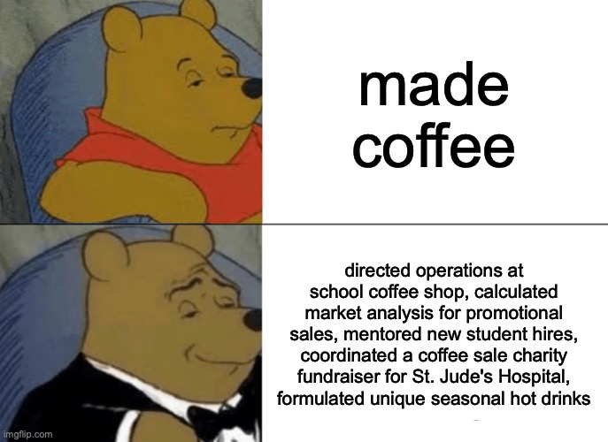
Notes:
Don’t sell yourself short, but don’t oversell either. Readers can smell BS a long way away.
One trick is to anchor each skill you are bragging about in a job duty, experience, or praise you had. “Delivered exceptional customer service” sounds a bit overblown, but “Recognized for customer service skill by being named employee of the month twice” is believable.

Slide 51
Resume Sentences
Cut the subject: “I”
Start with a powerful verb
List job duties only if not obvious
Give evidence of skills in action
Use more meatball words than noodle words

Slide 52
Meatball Words
Managed personal and commercial accounts, processed daily deposits and withdrawals, and administered safe deposit boxes.
Maintained a professional decorum and exemplified the standards of the bank while interacting with and meeting the needs of dozens of customers per day.
Filled in at other branches periodically.
Notes:
Powerful verbs and interesting nouns are meatball words, and they keep a reader’s attention much better than prepositions, articles, helping verbs, and the like.

Slide 53
Putting It Together
Notes:
Here are several real-world examples of resumes (all but Charlotte’s, however, are for college grads). You can see how they differ in how they treat their content and how they approach formatting.
All of these were made in Microsoft Word (except for Val’s), proving you don’t need elaborate software to make a readable, beautiful resume.

Slide 54
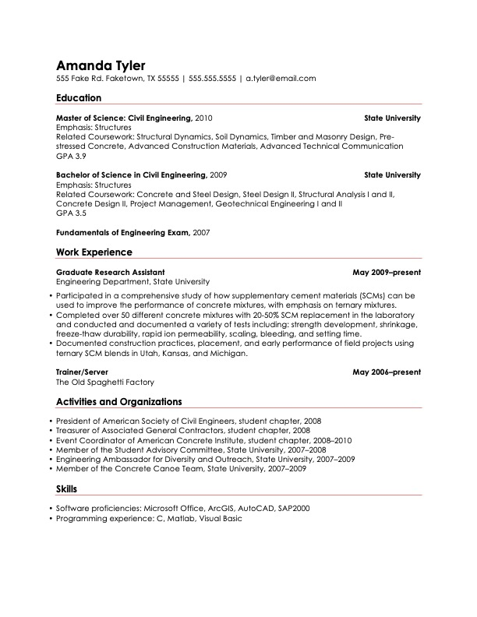
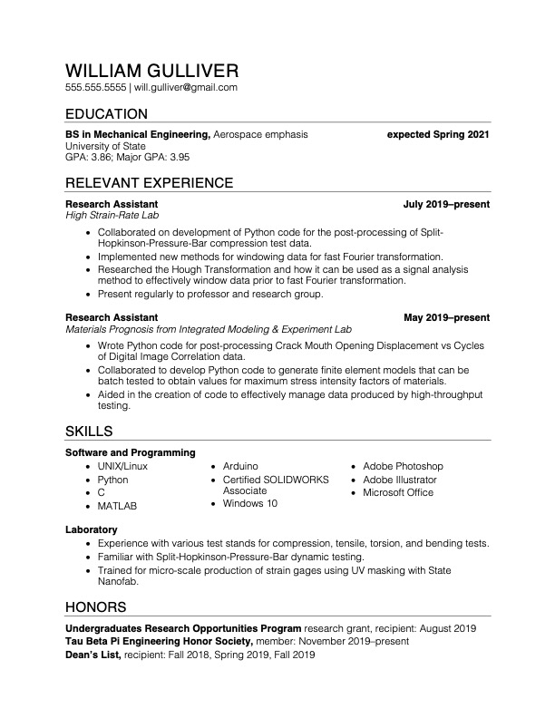
Notes:
Amanda was an engineering master’s student applying for her first career position. William was an engineering undergraduate applying to graduate school.
Notice how Amanda includes her job as a server but doesn’t waste space saying anything about it—it’s presence alone proves she could hold down a job and school simultaneously, which is enough in this context.
Notice how William cleverly arranges his skillset.

Slide 55
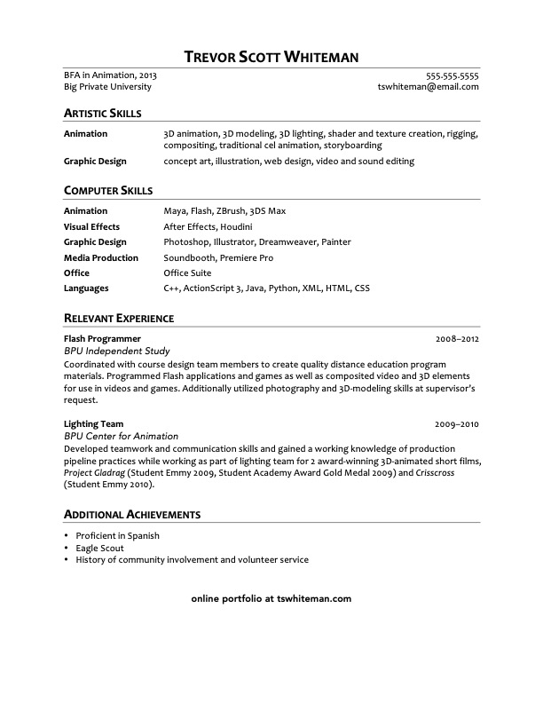
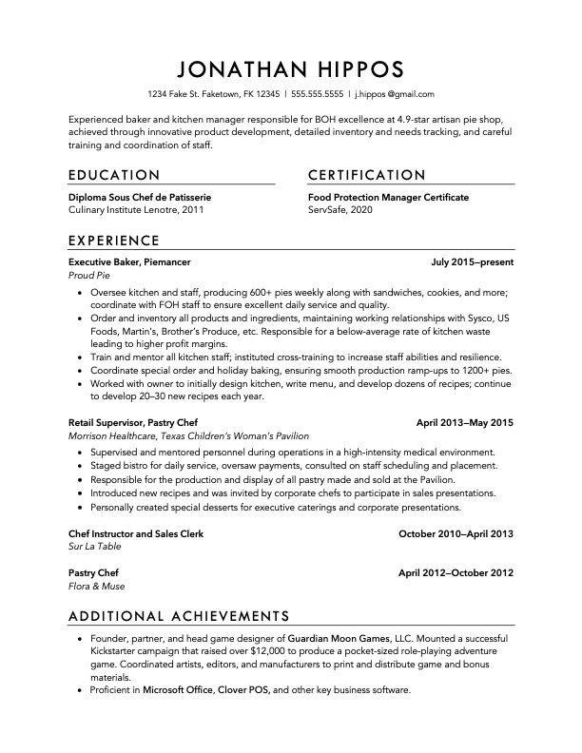
Notes:
Trevor, a computer animator, focuses on skills and experience (and doesn’t even have a section for education!) because that’s what studios value most. He also links to his portfolio.
Jonathan, a chef, focuses on his on-the-job experience because that’s what proves a chef’s skill.

Slide 56
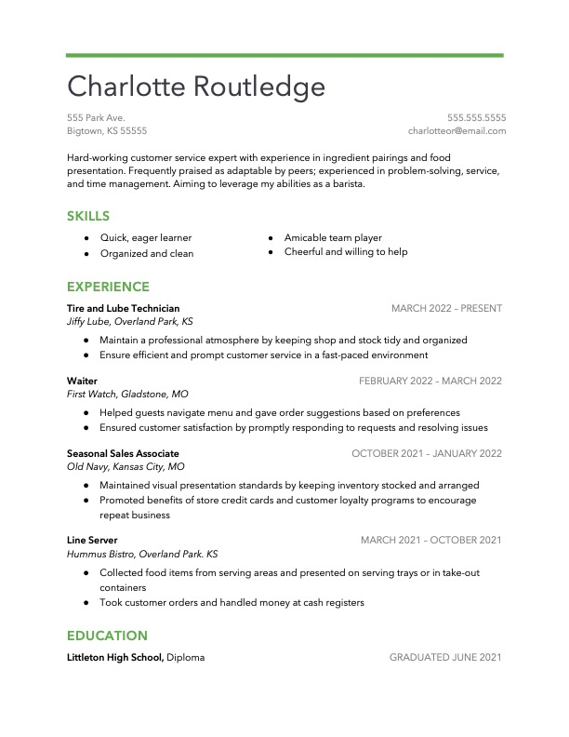
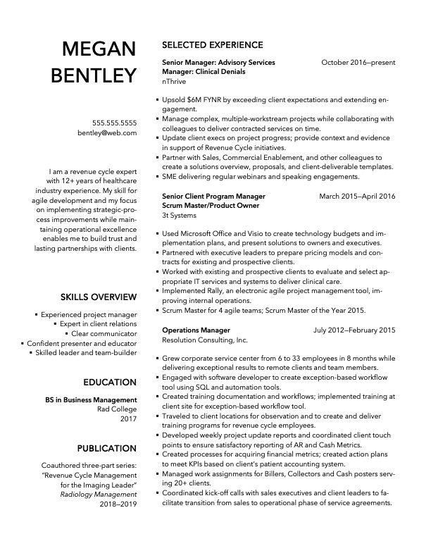
Notes:
Charlotte is a recent high school grad looking for a barista job.
Megan, an experienced professional, uses a columned approach to cram a lot of info on one page and keep it organized and readable.

Slide 57
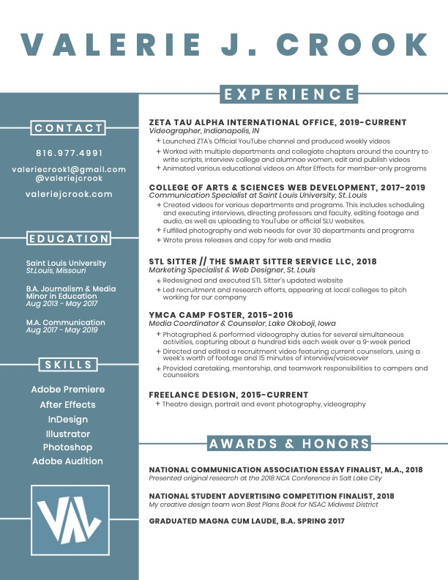
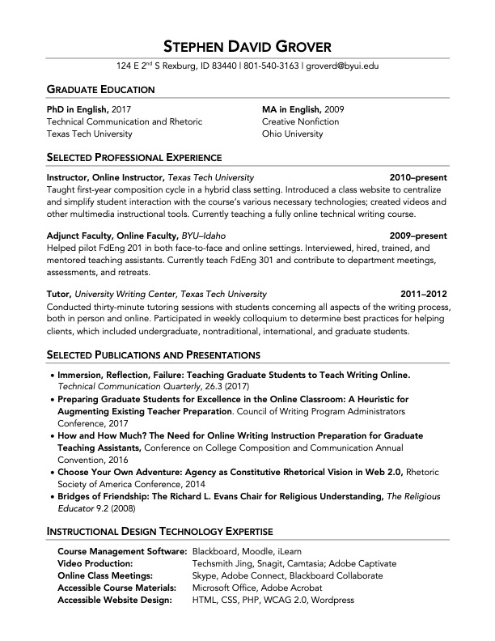
Notes:
The design of Valerie’s resume is tangible proof of her artistic ability.
David’s resume (that’s me!) includes a section on publications and presentations because that’s a key part of an English professor’s gig.

Slide 58
For more info, slides, handouts, etc.
groversenglish.com

